Slide 1
EET Presentation
Group Members
Apil Lamsal
NPI000017
(Conclusion)
Bijay Kumar Karki
NPI000020
(Critical Analysis)
Bishwash Bhandari
NPI000025
(Project Outcomes)
Ishwor Gautam
NPI000027
(Critical Analysis)
Nabin Chhetri
NPI000032
(Hiring Trend)
Pradip Kunwar
NPI000034
(Outcomes)
Rabin Acharya
NPI000035
(Introduction)
Sandesh Giri
(NPI000041)
(Hiring Trends)
Sandesh Subedi ‘A’
NPI000040
(Hiring Trend)
Sauraj Ranabhat
NPI000046
(objectives)
Suraj Pandey
NPI000051
(Hiring Trend)
Tej Bahadur Thapa NPI000054
(Organizational Chart)

Slide 2

Introduction
Infosys PVT. LTD. is a software development company founded by a group of specialists.
Providing tech solution to clients since 2019.
Employee having extensive experience in the field of information technology.
Aims to construct a software development workforce that uses cutting-edge technology.
Provides products and services to business of any size.

Slide 3
Introduction (Cont...)
Vision
Infosys Tech Pvt. Ltd. has a vision to become Asia's top software technology supplier.
Produce high-quality mobility products and services and collaborating with the most innovative computing solution providers.
Bypass client’s expectation and create a competitive advantage.
Mission
“Equip the world with next-generation software applications to unlock their full potential, increase their productivity, and boost their success”

Slide 4
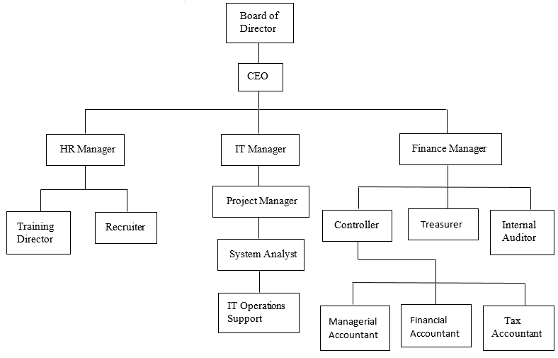
Organizational Chart
An organizational chart is a diagram that shows an organization structure.
Helps employees clearly identify all team leaders within their organization.
Minimizes the amount of time wasted dictating who to pass on information to.
Overall optimization of organization when it comes to efficiency and communication.

Slide 5
Hiring Trends
Hiring trends is the process of investigation about the expectation for the further job hunters and employee.
Our company “Infosys Pvt.Ltd” follow four trends which suits for our organization behaviors.

Slide 6
Artificial Intelligence
AI or artificial intelligence, program of a machine works as human intelligence.
AI is set to learn and solve the problem as human through machine.
Select ideal candidate through AI program.
Analyzed the resume for right candidates.

Slide 7
Company Benefits by AI
Numbers of interview can conduct through AI program in order to select ideal candidates.
Chance of spreading COVID – 19 virus to all employee will be less while hiring ideal candidates.

Slide 8

Remote Work
Helps company find top talent avoiding geographical barriers
Values Flexibility
Improves employee work-life balance
Co-working Spaces

Slide 9
Reviewing Social Background History
Criminal background
Financial position. (tax lies, bankruptcies, etc)
Previous job experience and loyalty
Separate reservation seat for under privileged group
Checks candidate identity

Slide 10

Company Culture
Overall personality and culture of an organization.
The daily routine, working environment and productivity of an employee.
Employees Adaptability.
Understanding the behavior and culture of the company.

Slide 11
Our Project
Workshop = “Better Environment in Workplace”
Timing: One day workshop
Target: Employees
Objective :
To aware employee about increasing productivity
Improving morale
Promoting collaboration
Providing idea on creating proper working environment in the company.

Slide 12
Outcomes of the project
Awareness about the importance of Better Environment in Workplace and how to create it within the organization.
Design of Safe and comfortable workplace
Better lightening
Proper Arrangement of Furnitures
Use of modern tools and technologies for working
Proper Ventilation
Ensuring security

Slide 13
Outcomes of the project
2. Focus on improving behavioural components:
Better collaboration and communication.
Better performance of the employee.
Motivation of employee.
Increase employee morale.
Safety and harmonious environment at workplace.
Sustainable employee.
Provide learning opportunity for the employee.

Slide 14
Critical Analysis
The way of checking and comparing the description given on a subject.
Critical Analysis reflects the impact and validity of the subject on the ground level

Slide 15
Analysis For better Workplace Environment
Trust,Camaraderie and pride are considered as the major contributing factors that support the better workplace environment.
The ideal workplace consists of an environment that cultivates trust and sincerity
Better workplace ensures a healthy, wise and strong relationship towards the organization and among the coworker.
the employees realise the great workplace when their work is appreciated and make them feel that their work contributes to the organization

Slide 16
Critical Analysis on Artificial Intelligence
According to the prediction of McKinsey’s Global Institute model ,” approximately 70 percent of companies will adopt some form of AI by 2030” (A.I. Could Spur Global Growth as Much as the Steam Engine Did, Study Shows, n.d.).
Computer Program to execute a task.
Machine Learning - collecting data in the process of execution and evaluating data to predict next outcome.

Slide 17
Critical Analysis on Artificial Intelligence
Artificial Intelligence in Hiring Trend:
After the vacancy announcement is done by the system and the CV that came into the system are automatically shortlisted as per the skills and experience.
Equality is provided for all the candidates.
Better selection process.
Companies save time, money and effort for the selection

Slide 18
Critical Analysis on Artificial Intelligence
Artificial Intelligence Disadvantages in Hiring Trend:
In current situation the recruitment software is a challenge to make as highly qualified programmers are needed.
Some decisions that a human mind could make cannot be made by AI software.
Input should be given as instructed

Slide 19
Critical Analysis on Artificial Intelligence
Use of Artificial Intelligence in Hiring Trend in Infosys Tech Pvt. Ltd. :
a positive message in the market
employees that are being hired through this process are with a positive attitude and have a high level of dedication
gain customers and people's attraction toward the company.

Slide 20
Conclusion
We have successfully conducted our workshop on “Good Workplace Environment”.
Overall the workshop conceded the importance of communication, trust, work division, mutual understanding, transparency, credit for contribution in an organization for productive and sustainable output.

